Slide 1
ACCESS MODIFIERS IN JAVA

Slide 2
Introduction
The access modifiers in java specifies accessibility (scope) of a data member, method, constructor or class.
There are 4 types of java access modifiers:
private
default
protected
public

Slide 3
Private Access Modifier
The private access modifier is accessible only within class.
Example:
class A
{
private int data=40;
private void msg(){System.out.println("Hello java");}
}
public class B
{
public static void main(String args[])
{
A obj=new A();
System.out.println(obj.data); //Compile Time Error
obj.msg(); //Compile Time Error
}
}

Slide 4
Private Constructor
If you make any class constructor private, you cannot create the instance of that class from outside the class.
Example:
class A
{
private A(){} //private constructor
void msg(){System.out.println("Hello java");}
}
public class B
{
public static void main(String args[])
{
A obj=new A(); //Compile Time Error
}
}

Slide 5
Note: A class cannot be private or protected except nested class.

Slide 6
Default Access Modifier
If you don't use any modifier, it is treated as default bydefault. The default modifier is accessible only within package.
//save by A.java
package pack;
class A
{
void msg(){System.out.println("Hello");}
}
//save by B.java
package mypack;
import pack.*;
class B
{
public static void main(String args[]){
A obj = new A();//Compile Time Error
obj.msg();//Compile Time Error
}
}
The scope of class A and its method msg() is default so it cannot be accessed from outside the package.

Slide 7
Protected Access Modifier
The protected access modifier is accessible within package and outside the package but through inheritance only.
The protected access modifier can be applied on the data member, method and constructor.
It can't be applied on the class.

Slide 8
//save by A.java
package pack;
public class A
{
protected void msg() {System.out.println("Hello");}
}
//save by B.java
package mypack;
import pack.*;
class B extends A
{
public static void main(String args[])
{
B obj = new B();
obj.msg();
}
} Output:Hello

Slide 9
Public Access Modifier
The public access modifier is accessible everywhere. It has the widest scope among all other modifiers.
Example of public access modifier
//save by A.java
package pack;
public class A
{
public void msg(){System.out.println("Hello");}
}
//save by B.java
package mypack;
import pack.*;
class B
{
public static void main(String args[])
{
A obj = new A();
obj.msg();
}
} Output:Hello

Slide 10
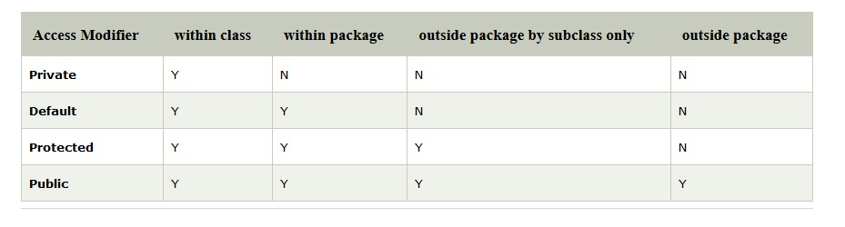
All Java Access Modifiers

Slide 11
Access Modifiers with Method Overriding
If you are overriding any method, overridden method (i.e. declared in subclass) must not be more restrictive.
Example:
class A
{
protected void msg(){System.out.println("Hello java");}
}
public class B extends A
{
void msg(){System.out.println("Hello java");}//C.T.Error
public static void main(String args[])
{
B obj=new B();
obj.msg();
}
}
The default modifier is more restrictive than protected. That is why there is compile time error.

